Slide 1
E-Healthcare_BSMRSTU
Project Supervisor: Dr. Mrinal Kanti Baowly Submitted by: Md. Juwel Mallick
Associate Professor Student ID: 18CSE018
Department of CSE, BSMRSTU Department of CSE, BSMRSTU

Slide 2
Presentation Outline
Introduction
Features
Objectives
Procedure
Advantage
Limitations
Future look

Slide 3
Introduction
E-Healthcare_BSMRSTU project is essentially a management system of healthcare of BSMRSTU. Here administrators get all the medical reports of all the members of the BSMRSTU community easily. Also, it reserved all the information of all members of BSMRSTU. Easily admin can insert, delete and update information. Every member of this community has an individual identity.

Slide 4
Features
Described Healthcare BSMRSTU
Reserved all data of this community
Get the health status of all user
Also found all other information of a user
Can insert and delete data from the dataset
Work as blood bank

Slide 5
Objectives
Promoting accurate information
Increase health safety
Easy to find information
Easy to get medical support
Easy to get blood donor for emergency

Slide 6

Procedure
Firstly it showed a welcoming message.
Here we get a login button for login and also have an exit button or close the application

Slide 7
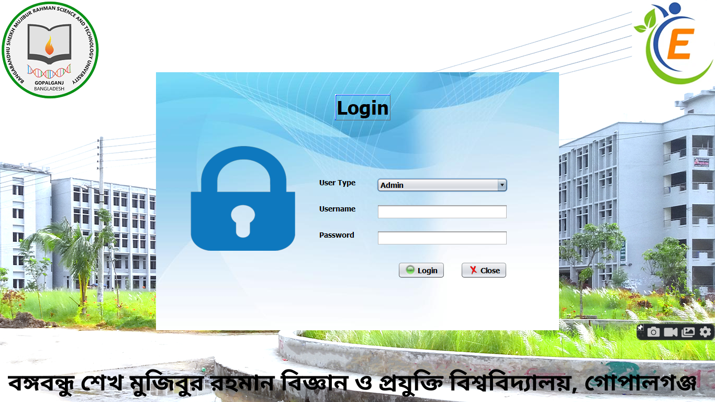
Procedure
We get a login page for login all types of users (admin, teacher, doctor, nurse, and student).
To successfully log in username and password must match with database data which is initially gotten from the admin.

Slide 8
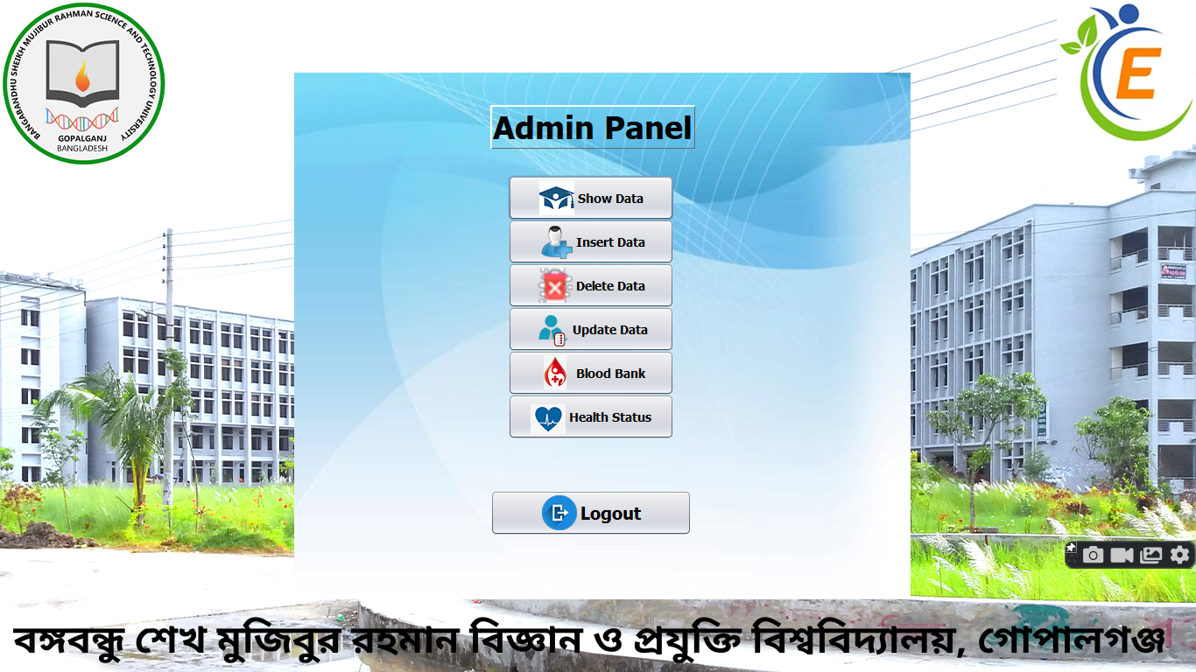
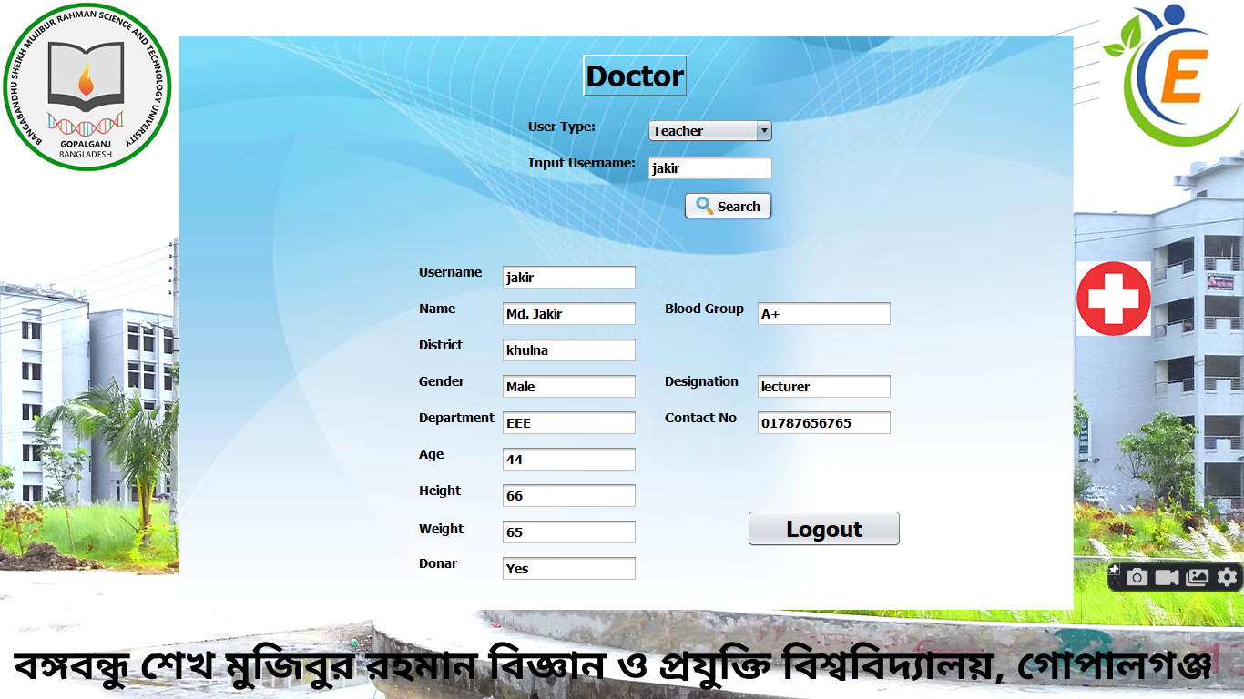

Procedure
Here we get the specific(as admin, doctor, nurse, student) window for managing the information

Slide 9
Advantage
Easy to access
Essy to find out correct information about the user
In a blink we can get all our desired information
Easy to maintain the health status
Increase our health safety
Easy to find blood donor
All information are secured

Slide 10
Limitation
There is less information here.
There are a few diseases.
There is a small dataset.
No direct connection between doctor and user
No help center

Slide 11
Future look
I want to add more information with the proper dataset
I want to add Graph & Chart for statistics
I want to add monthly health status features.
I want to develop a webpage for easy use.
I want to add telemedicine features in the webpage

Slide 12
THANK YOU

